Slide 1

Adam Stephensen
http://adamstephensen.com
@AdamStephensen
Solution Architect at SSW
Building Awesome Teams and Software
Focus on Enterprise Web and Development Best Practices
Principal Mentor @ FireBootCamp
Microsoft Australia Partner Award for Learning

Slide 2

VS 2015 + MVC 6 + Angular = Awesomeness (After lots of initial pain)
@Adamstephensen | Solution Architect @ SSW
Notes:
I’ve just finished my first application using Visual Studio 2015, MVC 6 and AngularJs
I’m so excited to be be building enterprise web apps, leveraging all the front end best practices developed by the javascript community, using my C#, MVC and WebAPI skills for the backend and doing it all with the productivity of visual studio, .

Slide 3

Dependency Injection Now a First Class Citizen

Slide 4

Previously
Webforms – TERRIBLE DI Support
ASP.Net MVC – Partial Support

Slide 5
DI with ASP.Net 5
Available throughout the entire stack
Minimalistic DI Container is provided out of the box
Support to BYOC (Bring your own container)

Slide 6
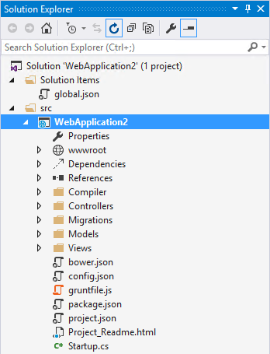
Implementation
IServiceProvider interface
Used across all framework components (MVC, Routing, SignalR, Entity Framework, etc)
Can now share dependencies across the stack
Notes:
There are major changes to the solution structure, which we will have a look at in a future video

Slide 7
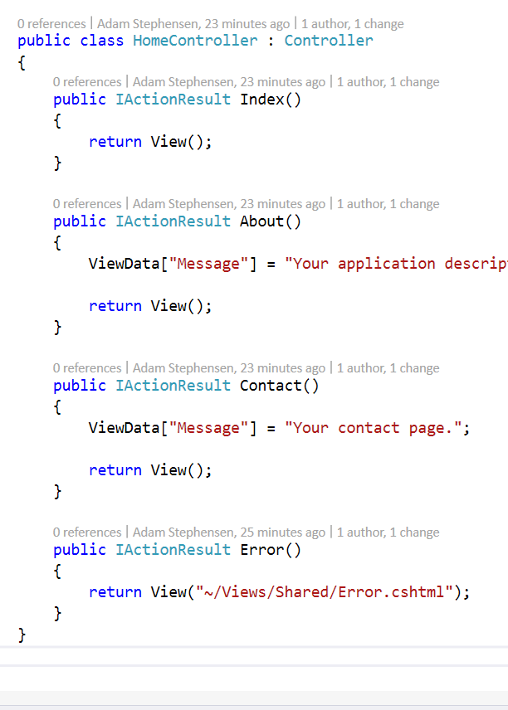
Disappointment
Controllers still don’t have DI out of the box
The same controller should be an instrument of best practice
Notes:
There are major changes to the solution structure, which we will have a look at in a future video

Slide 8
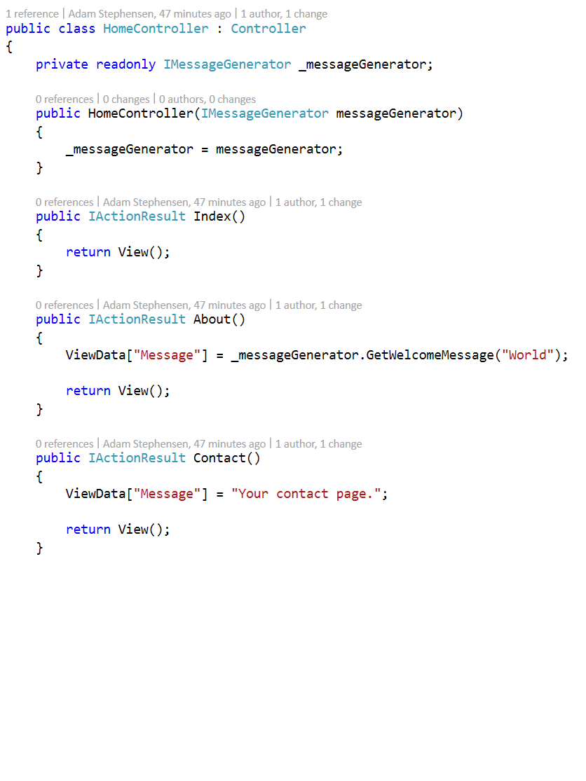
Better Default HomeController
Notes:
There are major changes to the solution structure, which we will have a look at in a future video

Slide 9

Summary Thank you: You helped me know what's awesome!
Big changes to solution structure
NPM, Bower & Nuget Package Managers
Front End Build with Gulp / Grunt
ASP.NET 5 (was vNext)
Lots more to come goodies to come
Summary

Slide 10
10. Dependency Injection
?
Built in
Startup.cs uses it
StructureMap, AutoFac, Ninject, Windsor, and Unity
Today at SSW we create Domains, Onion Architecture and DI (StructureMap or AutoFac)…
using Microsoft.Framework.DependencyInjection; public class Startup { public void Configure(IBuilder app)

Slide 11
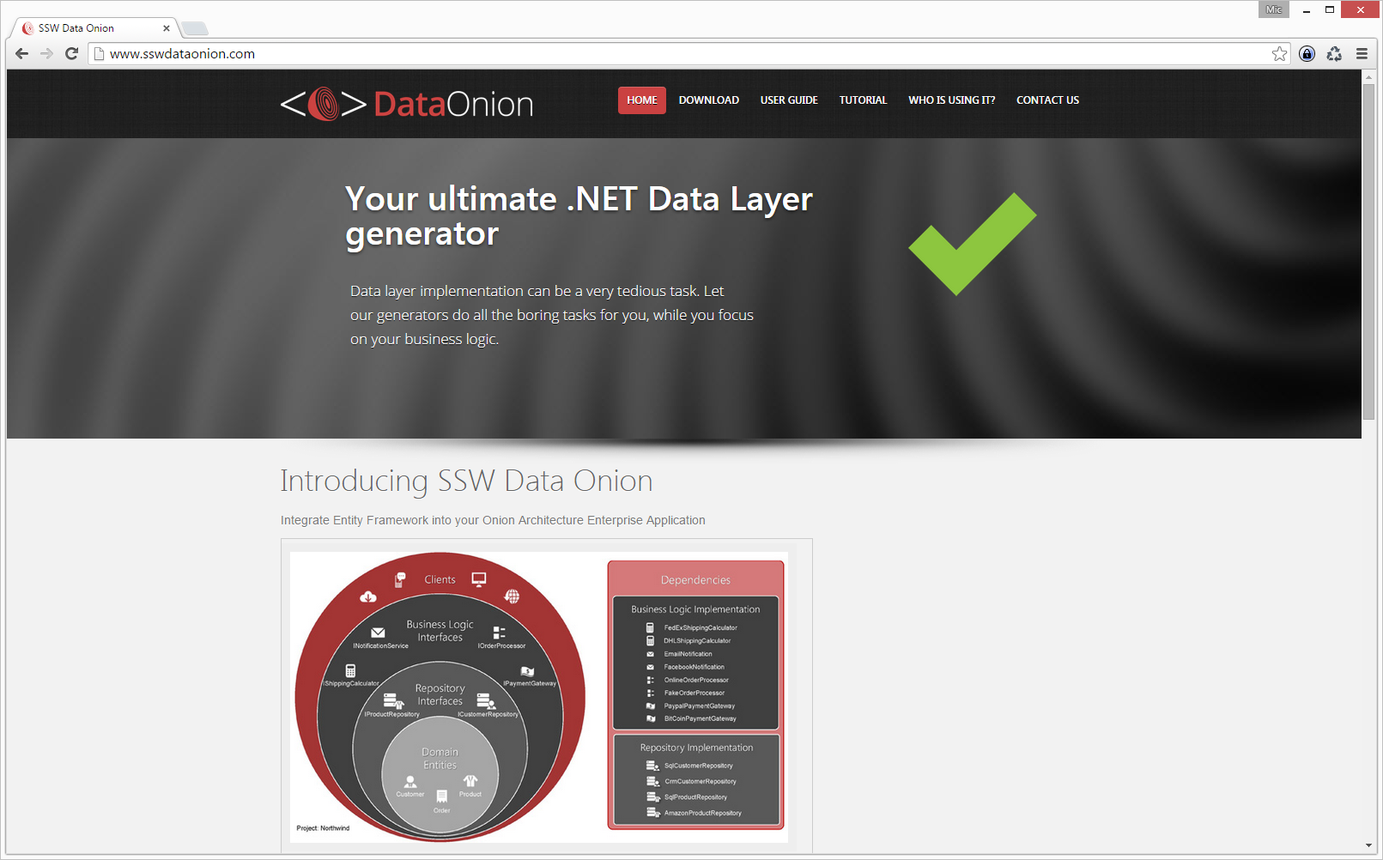

Slide 12
Dependency Inject
Can use it in Razor page too
@using WebApplication23
@inject TimeService TimeSvc
<h3>@ViewBag.Message</h3>
<h3>
@TimeSvc.Ticks From Razor
</h3>

Slide 13

Mind Blown?
Stay Tuned !
Notes:
OK. Yes. It’s all a bit much.
*** Next ***
It took us weeks of working with the new stack to work out how everything worked….
, and our best practices are still evolving.
*** Next ***
But we want to help you out by sharing what we’ve learnt so far
So stay tunes and we’ll be putting together lots of great content to help you get up to speed as easily as possible.
.. And get shipping awesome apps on the latest technologies.

Slide 14
Thank you! info@ssw.com.au www.ssw.com.au Sydney | Melbourne | Brisbane | Adelaide
Tweet your favourite feature
@AdamStephensen #NetUG
Notes:
Thanks for listenting, and please drop me a tweet with your feedback

